Slide 1
Final Engagement
Attack, Defense & Analysis of a Vulnerable Network
Cameo Reindl, Phil Snell, Abdisalan Firin, Mary Yang, Georges Avenie, Omolabake Oladimeji, and Abdirahman Abdullahi
Notes:
Cameo
Hi everyone! I’m Cameo. My group is going to be sharing the Network Analysis portion of the project done in Wireshark. We are Cameo, Phil, Abdisalan, Mary, Georges, Cherish, and Abdirahman

Slide 2
Table of Contents
This document contains the following resources:
Network Topology & Critical Vulnerabilities
Traffic Profile
Normal Activity
Malicious Activity
Notes:
Cameo
Our presentation will touch on the Network topology and critical vulnerabilities as well as the traffic profile, and normal and malicious activity that was discovered on Wireshark.
First up, we’ll have Abdi talking about the Network Topology and Critical vulnerabilities

Slide 3
Network Topology
& Critical Vulnerabilities
‹#›
Notes:
Cameo
Network Topology and Critical Vulnerabilities.

Slide 4
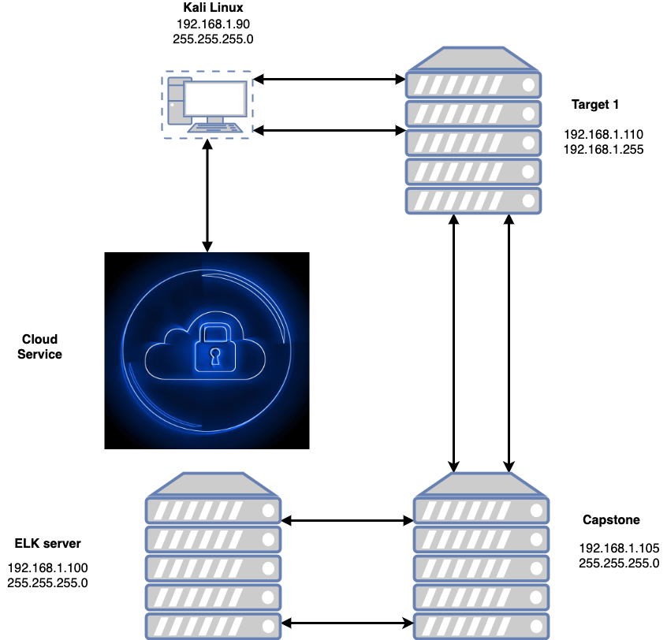
Network Topology
Network
Address Range: 192.168.1.0/24
Netmask: 25.255.255.0
Gateway: 192.168.1.1
Machines
IPv4: 192.168.1.90
OS: Linux
Hostname: Kali
IPv4: 192.168.1.110
OS: Apache Server
Hostname: Target-1
IPv4: 192.168.1.105
OS: Linux Server
Hostname: ELK Stack
IPv4: 192.168.1.100
OS: ELK
Hostname:Hyper-V
Azure Machine
ML-REFVM-6844247
Notes:
Abdi
This network diagram shows that cloud service acting as a hyper v and DNS gateway, the kali linux machine we used to hack into Targets 1 and the ELK machine that we used monitor our target 1 and capstone machine and also to create alerts in Kibana prior to the attack.
Traffic coming from the internet goes to each machine. The Target 1 VM has ports 22 and 80 open and here attackers to gain access.
With these ports open anyone can gain access to another user’s information.
Monitoring these machines will be required to ensure no attacks are done. Using the ELK server Kabana tools to do this.

Slide 5
Critical Vulnerabilities: Target 1
Our assessment uncovered the following critical vulnerabilities in Target 1.
Vulnerability | Description | Impact
CVE-2018-1000030 Python privilege escalation | It’s a level of access and permissions needed to achieve the goal of accessing sensitive information | It takes advantage of vulnerability to provide the attacker with privileges
CVE-2021-28041 ssh remote login | It allows users to connect to different networks from their local machine | The connection between the client and the server is not encrypted and the attacker can easily recover packets and data in transfer also know as man in the middles
CVE-2019-15653 html password hash disclosure | Password disclosure via an insecure authentication mechanism | The password hash is viewable in plaintext and it is unsalted
CVE-2017-7760 exposed username and weak password | Michael’s password was his name - there was no requirement or protocol in place to have a strong password | User access to the wp-config.php file via nano. This exposed MySQL password
Notes:
Abdi
this is were kind of covering what types of vulnerability we found on our target 1 machine.
the most pressing one we found is python privilege escalation, were we able to leverage a very common simple one line python script to escalate and to use steven shell to root using his pseudo python access.
ssh remote is bad because unaccounted for attacker to have a privileged access to corporate resources.
html password hash is bad because a remote attacker can obtain password hash in viewable plain tax

Slide 6
Traffic Profile
‹#›

Slide 7
Traffic Profile
Our analysis identified the following characteristics of the traffic on the network:
Feature | Value | Description
Top Talkers (IP Addresses) | 185.243.115.84 166.62.111.64 | Machines that sent the most traffic.
Most Common Protocols | TCP/IP HTTP UDP | Three most common protocols on the network.
# of Unique IP Addresses | 2 | Count of observed IP addresses.
Subnets | 192.168.1.0/24 | Observed subnet ranges.
# of Malware Species | 1 malware File Name: JUNE11.dll Name: Trojan.Mint.Zamg.O | Number of malware binaries identified in traffic.
Notes:
Mary
From our analysis, we found that there were suspicious activities on the IPs listed next to top talkers
The protocols that were mainly used were TCP/IP, HTTP, and UDP
We were also able to verify 1 malware during this process

Slide 8
Behavioral Analysis
Purpose of Traffic on the Network
Users were observed engaging in the following kinds of activity:
Set up an Active Directory network.
Users created their own web server on the corporate network
Users watched videos on YouTube
Used BitTorrent software to download movies
“Normal” Activity
Watching YouTube, reading the news.
Use BitTorrent to download work related files
Suspicious Activity
Users created their own web server on the corporate network and set up Active Directory
New IP is in the range of 10.6.12.0/24 which is the same as the corporate
Adware was downloaded as a result of their Youtube activity
Use BitTorrent to download movies
Notes:
Mary
Some suspicious activities that we observed were Users setting up active directory, watching videos on Youtube, created their own web server on the corporate network, and used BitTorrent to download movies that were unrelated to work
BitTorrent isn’t suspicious per se, however, the way in which the users used it was. We’ll touch more on this in a later slide.

Slide 9
Normal Activity
‹#›

Slide 10

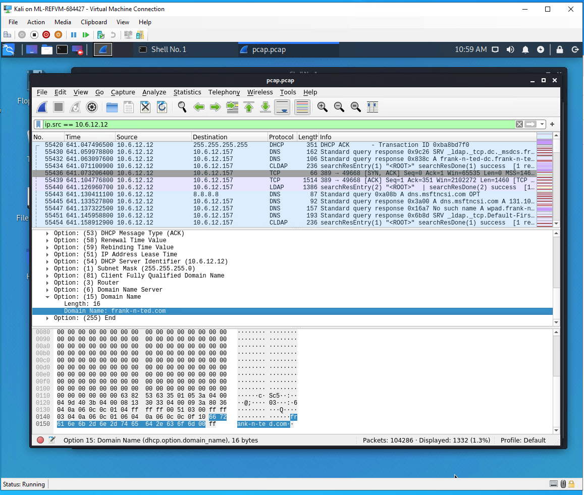
Watching YouTube, reading the news
Summarize the following:
We observed a lot of traffic using DNS
The user was watching YouTube videos
Notes:
Phil
Normal activities that we found, where Users were watching Youtube
As they were watching these movies you can see we were able to find the time wasters with the timestamp and the IP of each device.
Looks like they were creating a server called Frank-and-Ted.com on the network.

Slide 11
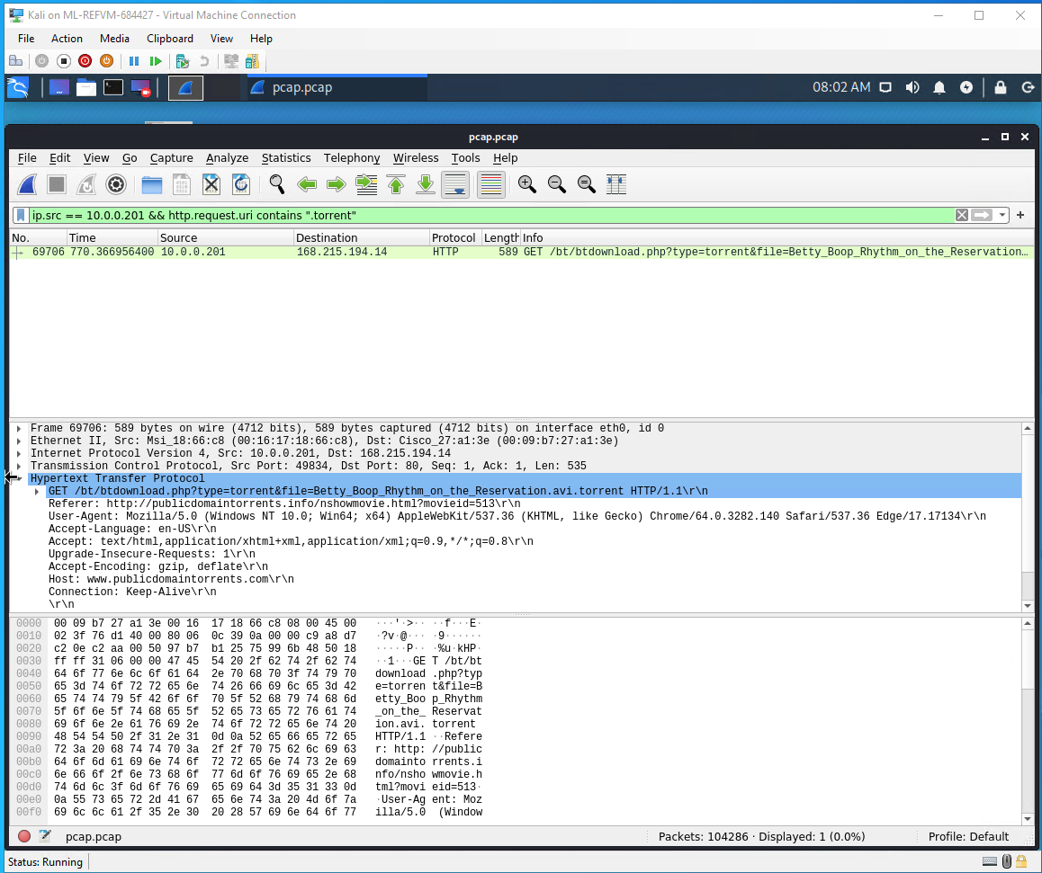
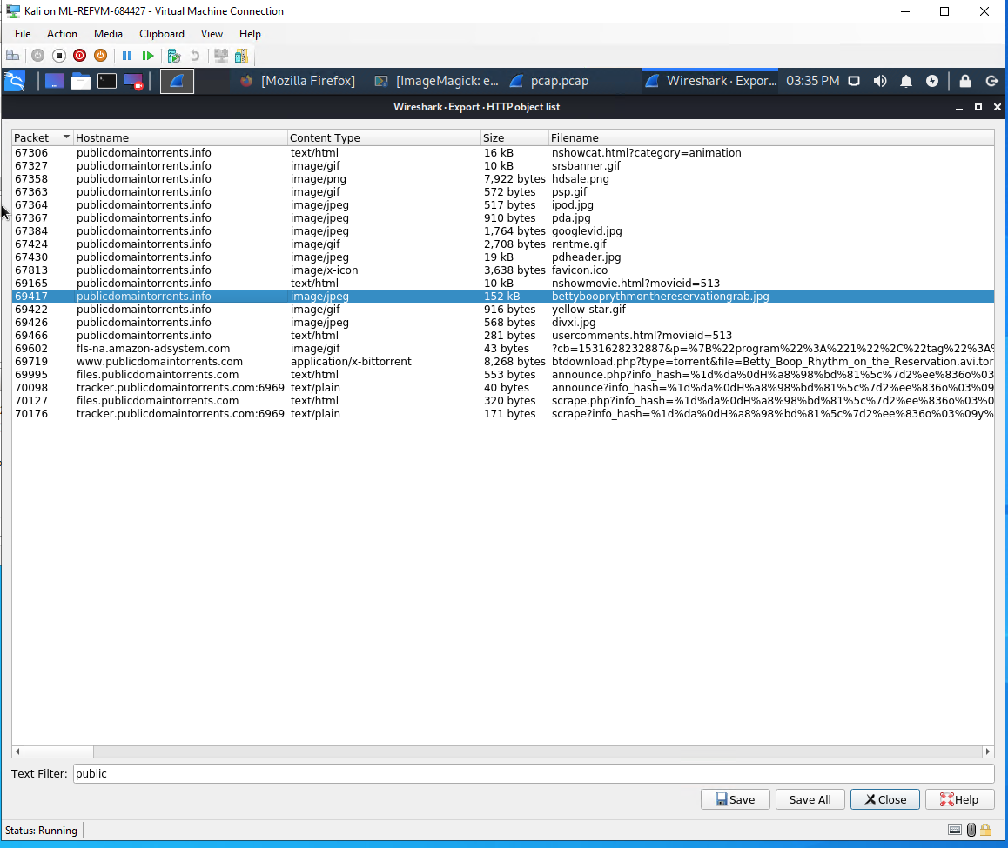
BitTorrent used to download work related files:
Summarize the following:
We observed HTTP traffic
Users were downloading work related files using BitTorrent
Notes:
Phil
On HTTP traffic, Users used BitTorrent to download files
The interesting file we found was betty boo an ( .avi ) files being illegally downloaded for copyright issues.
Looks like the user were surfing amazon, google, and other sites.
Cherris is up next with our Malicious activity.

Slide 12
Malicious Activity
‹#›

Slide 13
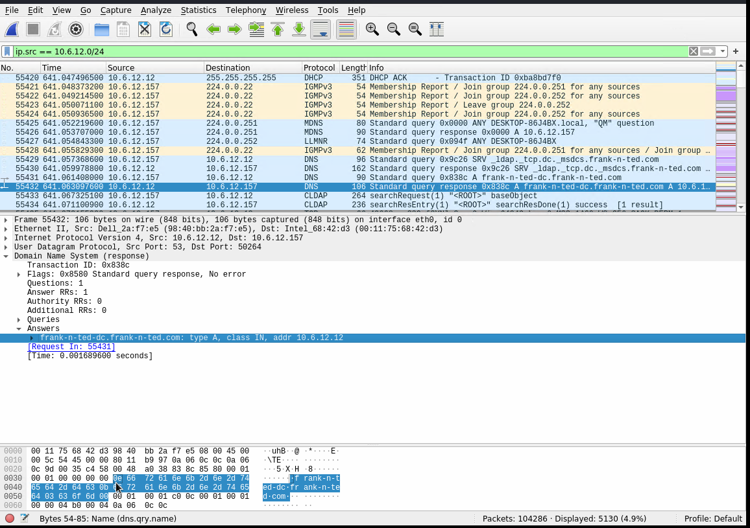
Users created their own web server on the corporate network and set up Active Directory
Observed the DNS protocol
It appears that the user has created a domain called frank-n-ted-dc.frank-n-ted.com
Notes:
Cherish
We see here that Frank and ted created a domain for themselve

Slide 14
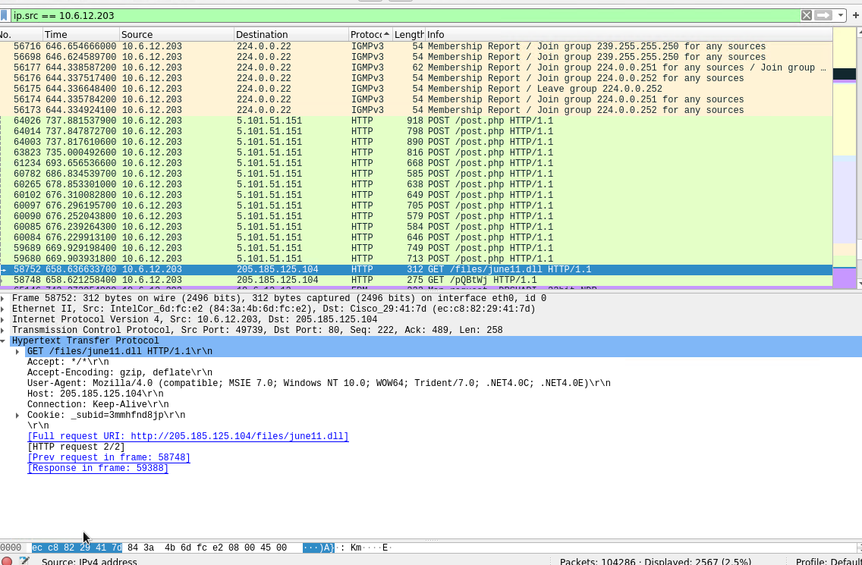
Adware was downloaded as a result of their Youtube activity
Summarize the following:
Observed the HTTP traffic
The user was likely watching Youtube videos and as a result of that clicked on a malicious adware that downloaded a malicious script onto
their computer.
Found a suspicious file called june11.dll
Notes:
Cherish
On HTTP traffic, we were able to see that Users were making a request, which downloaded a malicious script on their host machine
We were able to confirm this by uploading the june11 file into Virus total to see if it was malicious or not. This file was flagged as malicious and showed that the malware was an Ad-Aware called Trojan.Mint.Zamg.O
Adware, or advertising-supported malware, is a term used to describe unwanted software that displays advertisements on your device. An adware virus is considered a PUP (potentially unwanted program), which means it's a program that is installed without express permission from the user.
On the next slide confirms this..

Slide 15
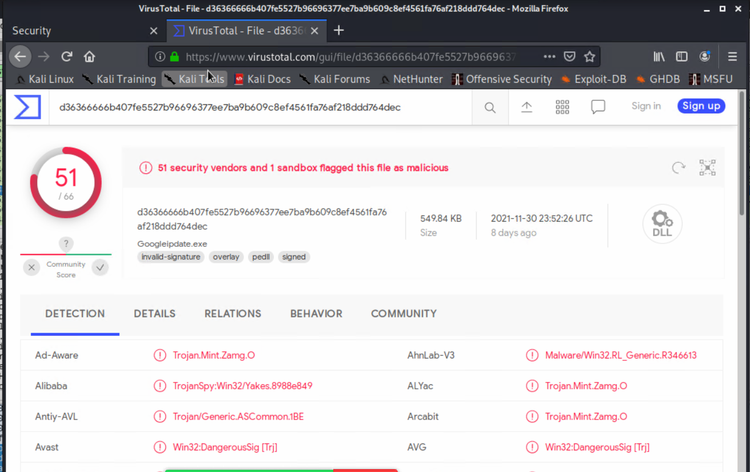
Proof of malicious file
Notes:
Cherish
We uploaded the june11 file into Virus total to see if it was malicious or not. This file was flagged as malicious and showed that the malware was an Ad-Aware called Trojan.Mint.Zamg.O

Slide 16

BitTorrent:
BitTorrent, when downloading videos from the internet, will take bits and pieces from others who already have the video on their own computer. This makes the download process faster. The more people who have downloaded the video, the quicker the download.
The users downloaded a movie through BitTorrent on HTTP.
Using BitTorrent for work purposes is allowed.
The movie downloaded was strictly against the company’s copyright infringement policy and therefore illegal.
Notes:
Georges
BitTorrent is a file transfer protocol that is used to download files, FOR EXAMPLE, when downloading videos from the internet, BitTorrent will take bits and pieces from others who already have the video on their own computer. This makes the download process faster. The more people who have downloaded the video, the quicker the download.
Downloading videos this way can be beneficial for the user, however, there is also a large risk of a virus when downloading pieces of a movie from multiple people over the internet.

Slide 17
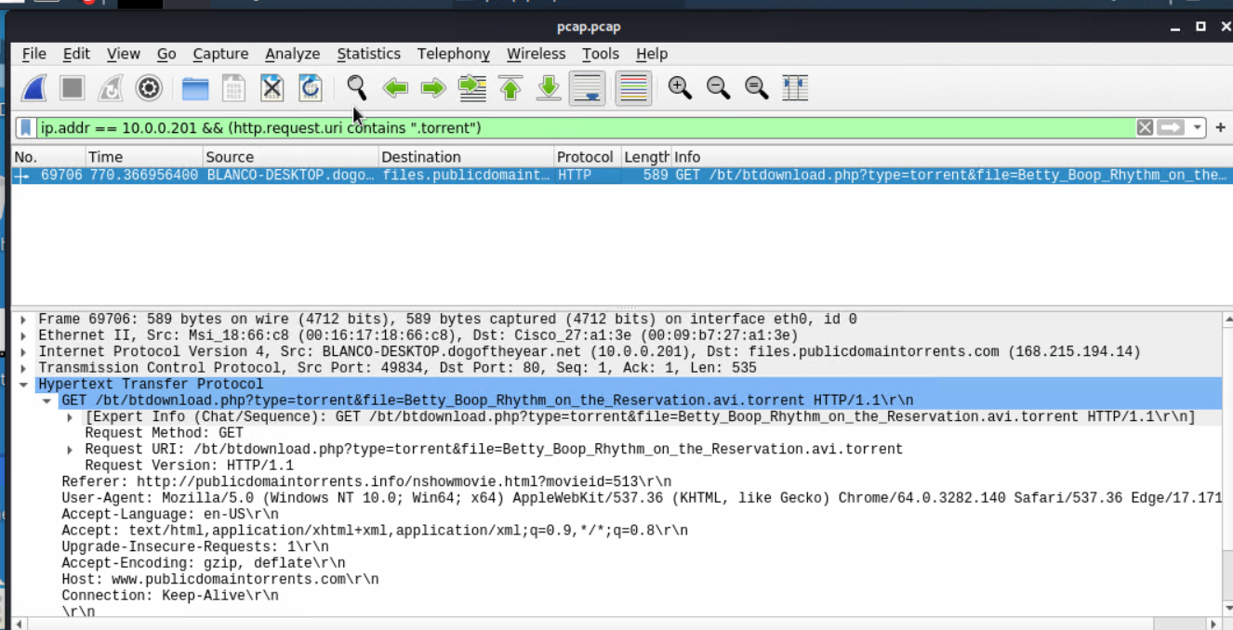
Betty Boop:
Notes:
Georges
This is a result of using BitTorrent.

Slide 18
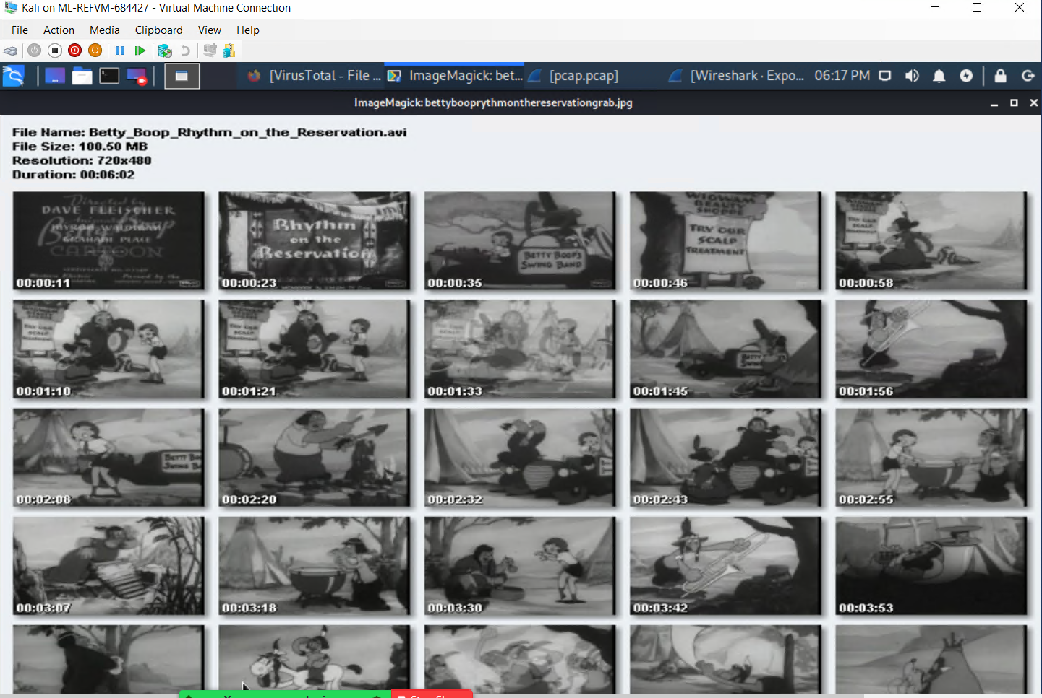
Notes:
Abdirahman
This is the Betty Boop video the users downloaded using BitTorrent. As we said earlier, using BitTorrent isn’t inherently illegal, however, downloading this movie went against the company’s copyright infringement policy.

Slide 19
That’s all folks!
That’s all folks!
That’s all folks!
A little something special for all of you!
Next Slide.
‹#›
Notes:
That’s all folks!

Slide 20
